Slide 1
Online shopping website
Guided By - Mr. Pankaj Kapoo

Slide 2
Team Members
Ramballabh Agrawal (Section A)
Naveen gupta (Section A)
Ayush Goyal (Section B)
Gopal Tiwari (Section B)

Slide 3
INTRODUCTION
Online shopping or shopping is a form of electronic commerce which allows consumers to directly buy goods or services from a seller over the internet using a web browser.
Customers can shop online using a range of different computers and devices, including desktop computers, laptops, tablet computers and smartphones.
Online customers must have access to the Internet and a valid method of payment in order to complete a transaction
Online stores are usually available 24 hours a day, and many consumers in Western countries have Internet access both at work and at home

Slide 4
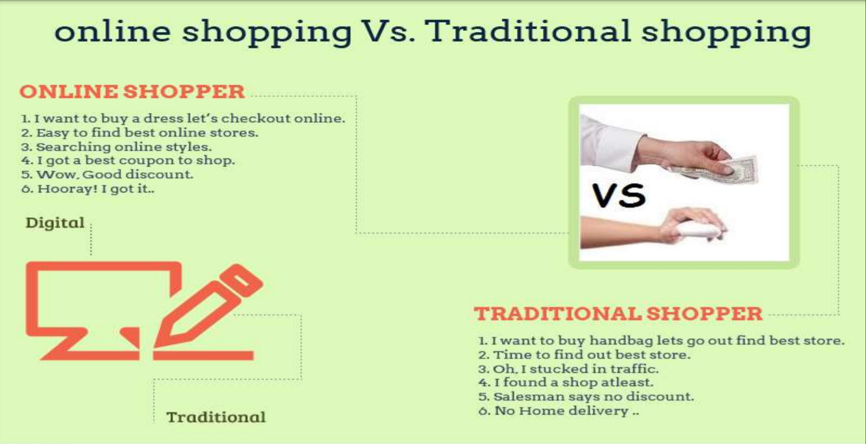

Slide 5
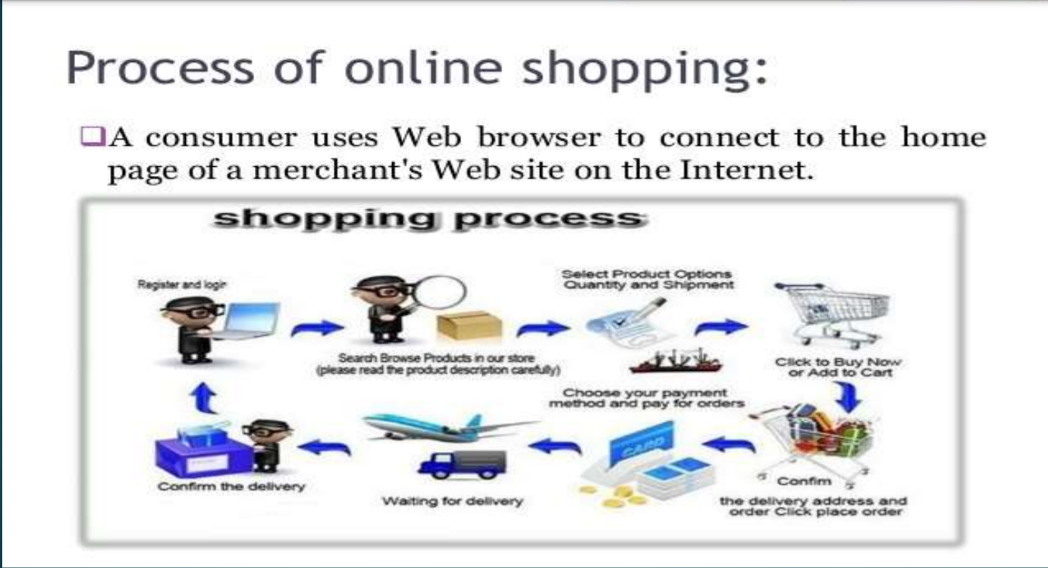

Slide 6
Future Scope
Online sales will continue to rise.
Every webpage designed to sell a product or market a service should understand future of online shopping.
Although the online buyer cannot return an item as quickly in some situations as the buyer who can walk in and out of a Wal-Mart or Sears when the parking lot isn't crowded or there is no line at the returns desk.
There are many other reasons to buy online. Such as Time Saving, Number of Variety of Products, etc.

Slide 7
Pros
1. Can shop for 24*7.
2. No need for cash in hand.
3. A lot of stores within a click away.
4. Comparison is easy.
5. No queue to wait.
6. Shopping Privacy.
7. Regular discount coupons available

Slide 8
Cons
1. Not able to touch or try.
2. Shipping and handling cost is more.
3. Credit/Debit card insecurity
. 4. Take much time if connection is slow.
5. Returning goods is difficult.
6. Actual product may differ
. 7. Availability of internet is Must

Slide 9
Conclusion
It is an user friendly application and promotes user to purchase and shop faster
With new technology comes better way of doing things
Being able to buy anytime anywhere.
Allows to place order before purchasing
Home delivery you don’t have to travel to shop.
Widespread effects on economy and e-commerce.

Slide 10
Thank you

